Slide 1
From Fragmented Journeys to Unified Experiences: Investigating Multifunctional Mobile App Design Through a Fitness Case Study
Marwan Ashhuby – Interim Presentation

Slide 2
SECTION 1: THE PROBLEM

Slide 3
The Problem: Fragmented Digital Journeys
Real task, real friction:
- Check workout plan → Notes app
- Time rest periods → Stopwatch app
- Log weight/reps → Tracker app
- View progress → Separate analytics app
The user becomes the integrator.

Slide 4
Autoethnography: Measuring the Fragmentation
One gym session, 52 minutes:
Literature alignment:
Oulasvirta (2005) — "Interaction in 4-second bursts"
González & Mark (2004) — Context switching costs
Metric | Value
App Switches | 23
Time spent between apps | 4 minutes 27 seconds
Cognitive reorientation events | ~23 (each switch)

Slide 5
SECTION 2: THE LITERATURE

Slide 6
Theoretical Framework
HCI Foundation | Mobile Reality | Design Target
Norman (2013): Gulfs of Execution & Evaluation | Oulasvirta (2005): 4-second bursts, divided attention | Cognitive load reduction
Nielsen (1994): Heuristics | González & Mark (2004): Task switching costs | Journey continuity
Shneiderman (2017): Direct manipulation | Porcheron (2018): Voice, hands-free contexts | Recognition over recall
Frameworks That Explain the Friction
The gap: Most usability evaluation is interface-level.
We need journey-level evaluation.

Slide 7
Service Design & The Journey Turn
From Interfaces to Journeys
Service Design (Stickdorn & Schneider, 2012):
"Experiences are sequences, not events."
Usability is not touchpoint quality.
It's how touchpoints work together.
Polaine, Løvlie, Reason (2013):
The shift:
From "Is this app usable?"
To "Does this ecosystem support coherent progress?"

Slide 8
SECTION 3: THE ANALYSIS

Slide 9
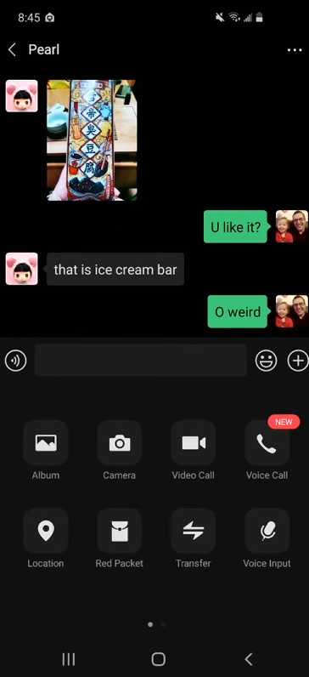
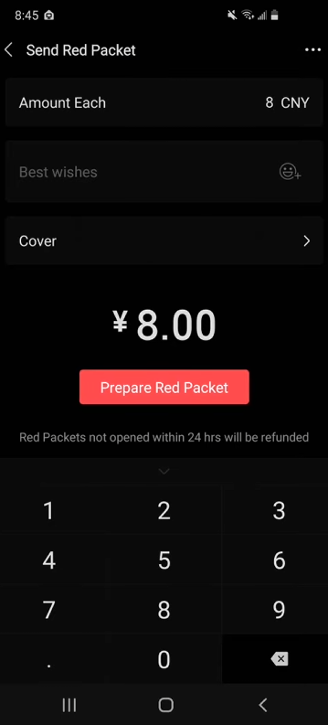
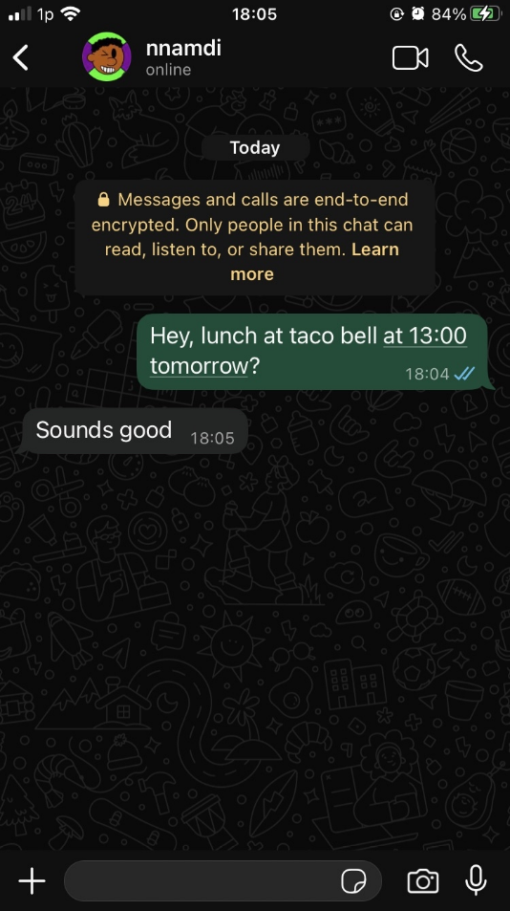
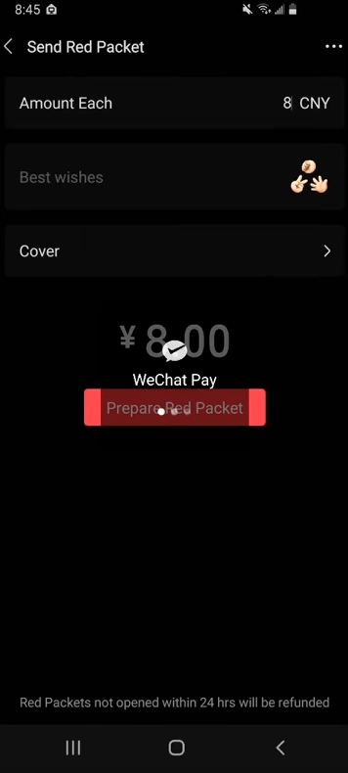
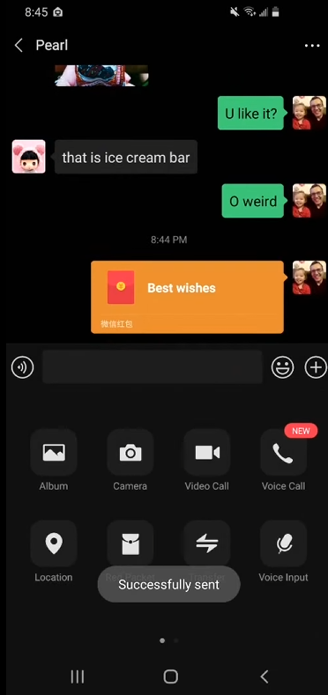
Cognitive Walkthrough: Two Paradigms
Comparative Analysis: Meta vs WeChat
Same goal: Coordinate lunch, pay a friend, share a photo.
Two radically different architectural philosophies.
We ask: What explains the difference in user experience?

Slide 10
The Meta Trap
Meta: Fragmented Federation
WhatsApp → Banking App → Instagram
Gulf of Execution: High — user moves data manually
Gulf of Evaluation: High — success state in three places
Context Switching: Severe — mental reload per app
Stage | Friction
Plan lunch | Copy/paste address, leave chat for Maps
Pay friend | Exit ecosystem, FaceID, manual entry, no chat feedback
Share photo | Post trapped in IG, cross-link back to WhatsApp manually

Slide 11
WeChat: The Encapsulated Super-App
WeChat: Zero-Exit Journey
Chat → Red Packet → Moments
Gulf of Execution: Low — actions available in context
Gulf of Evaluation: Low — feedback visible to both parties
Context Switching: Zero — single identity, single environment
Stage | Integration
Plan lunch | Built-in browser/mini-programs, never leave chat
Pay friend | Red Packet — payment inside chat thread, shared receipt
Share photo | Moments — same social graph, tag friend directly

Slide 12
Synthesis: What We Learn
Design Principles from the Walkthrough
From WeChat:
1. Actions should be available in context of the conversation/activity
2. Feedback should be shared between parties (closed loops)
3. Identity and social graph should persist across functions
From Meta's failure:
4. Aggregation ≠ integration
5. Users should not manually move data between apps
6. Notification debt accumulates across disconnected centers

Slide 13
SECTION 4: THE RESPONSE

Slide 14
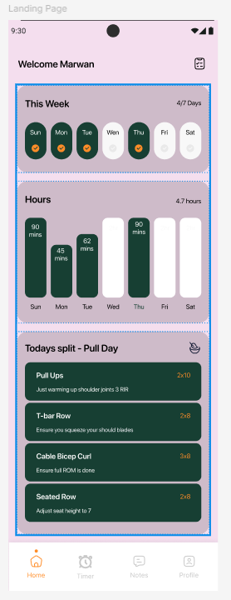
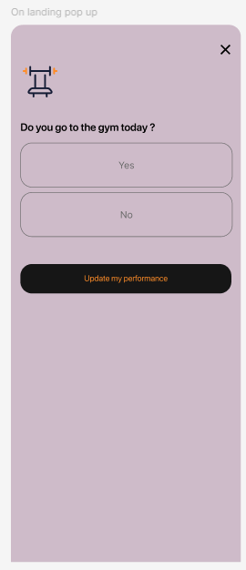
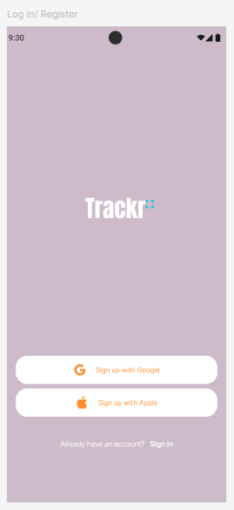
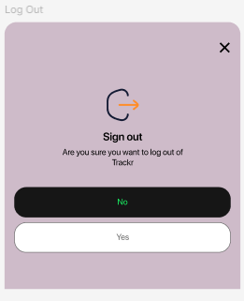
From Analysis to Design: Figma
Principles translated to features:
Principle | Implementation
In-situ action | Timer + note-taking inside workout view
Shared feedback | Progress visible immediately after set
Single identity | Unified data model across all functions
Recognition over recall | Library browsing, not searching

Slide 15
Choosing Our Stack: Native vs. Flutter vs. React
Android Native (Kotlin)
The Metal: JVM-based Bytecode.
The Win: Absolute best performance and smallest footprint for Android-only.
Flutter (The "Hybrid" King)
Dev Mode: JIT Compiled for instant "Hot Reload" (Speedy coding!).
Prod Mode: AOT Compiled to Native ARM Binary (Speedy execution!).
The Win: Near-native speed with one codebase.
React Native (The Web Pro)
The Metal: JavaScript Bridge + JIT Engine.
The Win: Familiar JSX syntax; perfect for teams coming from Web backgrounds.

Slide 16
Tech Stack: One Rep Architecture
One Rep: Technical Architecture
[UI] Flutter Widgets ← Riverpod Providers
↓
[State] Riverpod 3.0 (Notifiers, AsyncValue)
↓
[Repository] Type-safe data layer
↓
[Data Source] Drift (SQLite) ← Freezed models
↓
[Storage] Local .db file (offline-first)
Supporting: FL Chart, Local Notifications

Slide 17
SECTION 5: THE DEMO

Slide 18
Implementation Status
One Rep: Build Status
COMPLETE:
- Database schema (5 tables, relations)
- Exercise library with CRUD
- Auto-seeding on first launch
- Reactive streams (Drift → Riverpod → UI)
- Repository pattern, layered architecture
- Freezed models for type safety
IN PROGRESS / NEXT:
- Workout routines (builder view)
- Active session with set logging
- Rest timer (Local Notifications)
- Progress charts (FL Chart)
PLANNED:
- Usability testing protocol
- Comparative task analysis
- Cognitive load measurement (NASA-TLX)

Slide 19
Contribution & Closing
Contribution Summary
1. ANALYTICAL
- Comparative cognitive walkthrough (Meta vs WeChat)
- Extracted transferable design principles for unified journeys
2. TECHNICAL (in progress)
- Implemented offline-first, reactive fitness app architecture
- Demonstrates feasibility of multifunctional design in Flutter/Drift
3. EMPIRICAL (in progress)
- Autoethnographic baseline data (real fragmentation metrics)
- Planned usability study to evaluate fragmentation reduction
One Rep is not just an app. It's an instrument to investigate a question.

